Slide 1
Vista High School Action Plan
Cyrus Ortiz-Luis

Slide 2
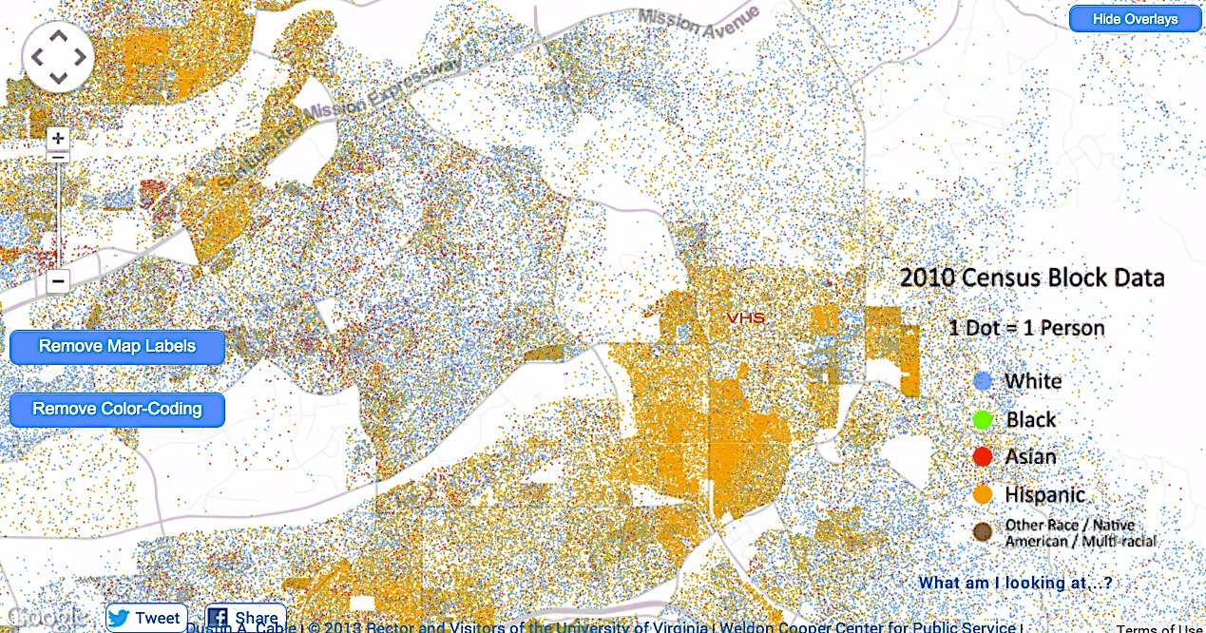
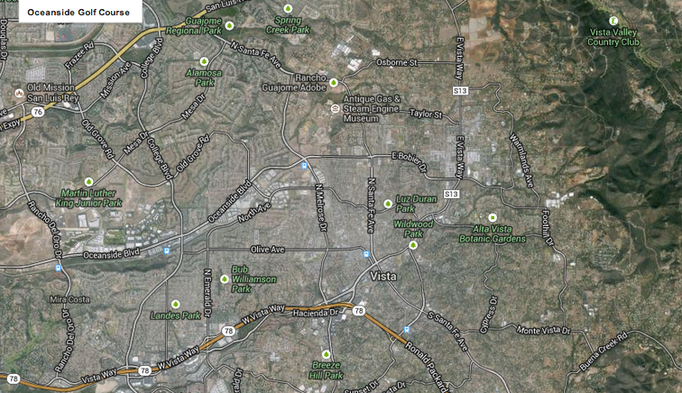
Community demographics

Slide 3
Percent demographics at VHS
81.7% of this population are also socioeconomically disadvantaged
+2.5% Hispanic every year
50.8% of VHS students are low SES AND Hispanic

Slide 4
CST (12-13) – Language Arts

Slide 5
CST (12-13) - Algebra 1

Slide 6
CST (12-13) – Life Science 10th grade

Slide 7
Action Plan – Improve assessment
Provide training for teachers to create authentic assessments and rubrics aligned w/ CCSS
Design/create/implement common assessments based on CCSS
Provide teachers with time to discuss and reflect on assessments
Teachers will share results in all staff meeting
Marzano, R. J., & Heflebower, T. (2011). Grades that show what students know. Educational Leadership, 69(3), 34-39.

Slide 8
Action Plan - AVID
Increase promotion of AVID in middle schools
“Celebrating Future Dreamers” w/ families & parents
Provide training for AVID teachers
Hire full time AVID teacher
Dean, J. C. (2009). The relationship between advancement via individual determination (AVID) and middle school student academic achievement and stakeholders' perceptions: A southern California case study. (Doctoral dissertation). Retrieved from http://ezproxy.csusm.edu/login?url=http://search.proquest.com/docview/964179520?accountid=10363. (ED527135)

