Slide 1
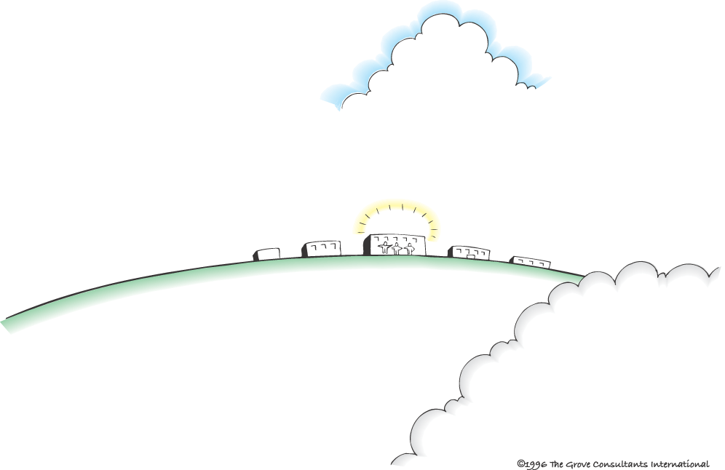
Vista HS’s Context Map
SOCIAL and CULTURAL
TRENDS
EDUCATIONAL
TRENDS
ECONOMIC
CLIMATE
POLITICAL Influences
and
LEGAL issues
• Access to Technology
• Common core
• Prop 30 & 32
• Teacher’s Union
• Political Climate
• Classroom size
NCLB/RTT/ADA/IDEA
Cyberbullying
FRISK
Freedom of Speech
Tinker
Teacher Contract
Documentation
CA Ed Code
Bad economy
Prop 30 & 32
Increased class size
Merit pay
Pink Slips
Temporary/Probationary/Permanent
Mainstreaming students
Homelessness and poverty
• Increase of Latino students → “white flight” to other HS
• Merit pay
• Social Media & Networking
cyberbullying
• PLC
• Homelessness
School goals
• NCLB
• Increased performance of Latino students and sped
• Aligning PLCs w/ School Values/Vision
• Improve student critical thinking for common core
SCHOOL SAFETY AS A PRIORITY
• Data driven teachers
Barriers
Parents who are not involved
• Teachers who are complainers and not problem solvers
Uncertainties
• New superintendent
• New administration (X3)
• Character Leader program
• PTSA
Barriers and UNCERTAINTIES
• Partnership w/ CSUSM STEM
California Ed Code
SUPPORT
FACTORS
Cyrus Ortiz-Luis

Slide 2
Social trends:
Resistance/dwindling of teacher unions
Immigration issues
Social media networking
Access to technology
Charter Schools (impacted by research)
Home school
Online school
Private/Church Schools
GI Bill Military have access to college education
Homelessness
Political & Legal trends:
NCLB/RTT/ADA/IDEA
Dream Act
State programs
Propositions
Funding
Merit Pay
Unions
Teacher/principal evaluation
School board elections
Economic trends:
Bad economy
Unemployment
Homeless students
Increase poverty
Increase class size
Merit Pay
Prop 30
Pink Slips
Program cuts
Educational Trends:
Common Core - NCLB
Class size increase
RTI (response to intervention)
PLC’s
Resistance or progressive to change
Accountability
Assessment/data
Leadership
Project based learning
Positive behavior intervention system
Purpose of Education:
Instill civic values in students
Common design of who we are as a nation
National culture of immigrants

